Slide 1
RealCommerce app based on Augmented Reality
Presented By:-
SHUBHAM(1090217015)
PRADEEP KUMAR(10900217037)
RAHUL GUPTA(10900217033)
NIKHIL KUMAR(10900217039)
Under the Guidance Of:
SUPARNA MITRA

Slide 2
What is Augmented Reality?
Augmented Reality is a combination of real scene viewed by a user and a virtual scene generated by a computer that augments the scene with additional information.

Slide 3
TYPES OF AUGMENTED REALITY
Marker Based
Marker Less
Projection Based
Superimposition Based

Slide 4
What is the GOAL of AR?
Create a system such that a user cannot tell the difference between the real world and the virtual implementation of it.

Slide 5
Augmented Reality vs Virtual Reality
Augmented Reality
Virtual Reality
System augments the real world scene.
User maintains a sense of presence in real world.
Needs a mechanism to control virtual and real world.
Total immersive environment.
Visual senses are under the control of system.
Concerned with only the virtual world.

Slide 6
Implementation of AR in E-Commerce
Customers so often face the hurdle of determining whether a certain product is right for them.
The website includes AR facility that offers shoppers the confidence that may motivate purchasing decisions.
Allows customers to view the in-depth information available online -- including reviews, related products and price -- while simultaneously looking at the actual physical product via the Reality App on smartphone.

Slide 7
Why is this an excellent Business strategy?
Segregation of similar E-Commerce concepts
Allows to include incredible value to undecided shoppers
Users hungry for digital customization- allows them to test out different color combinations according to their needs
Familiarity with new technology helps the customer to move ahead
New concepts in the global market always makes a Buzz!

Slide 8
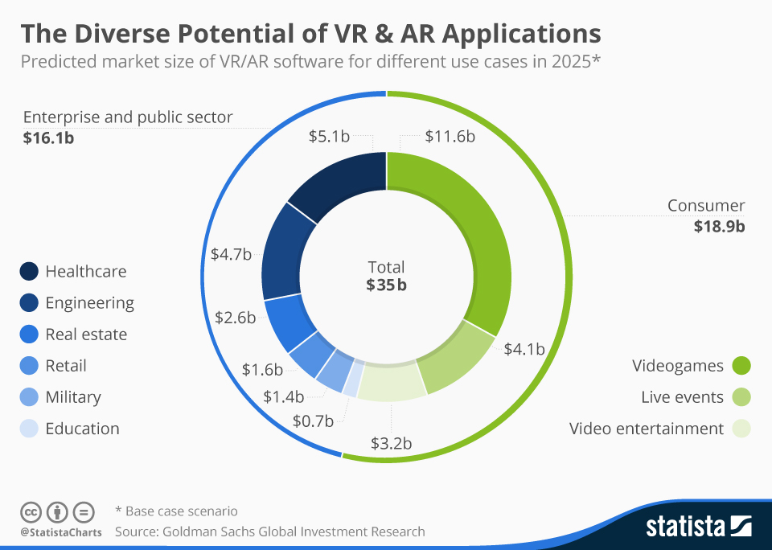
It truly Affects the Global Market!

Slide 9
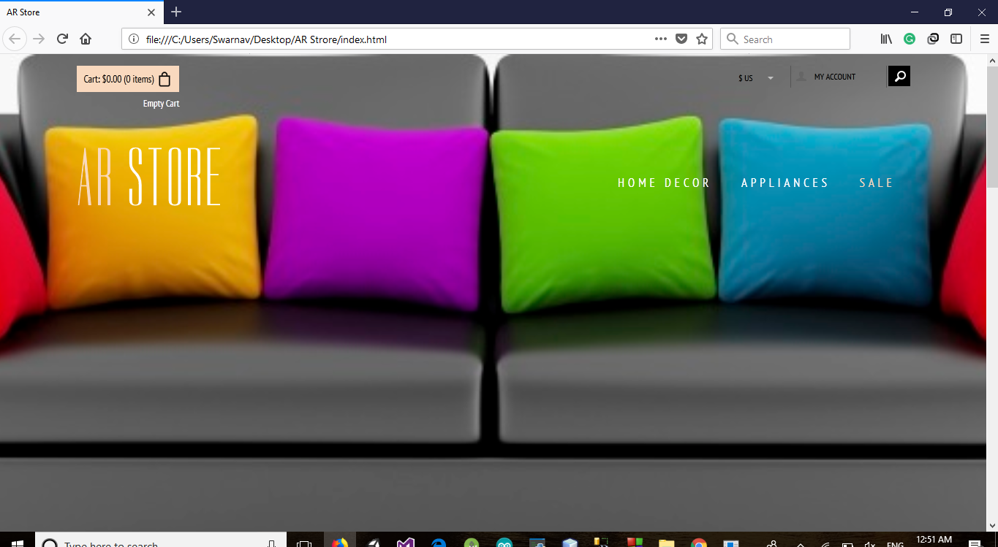
AR STORE -WEBSITE

Slide 10
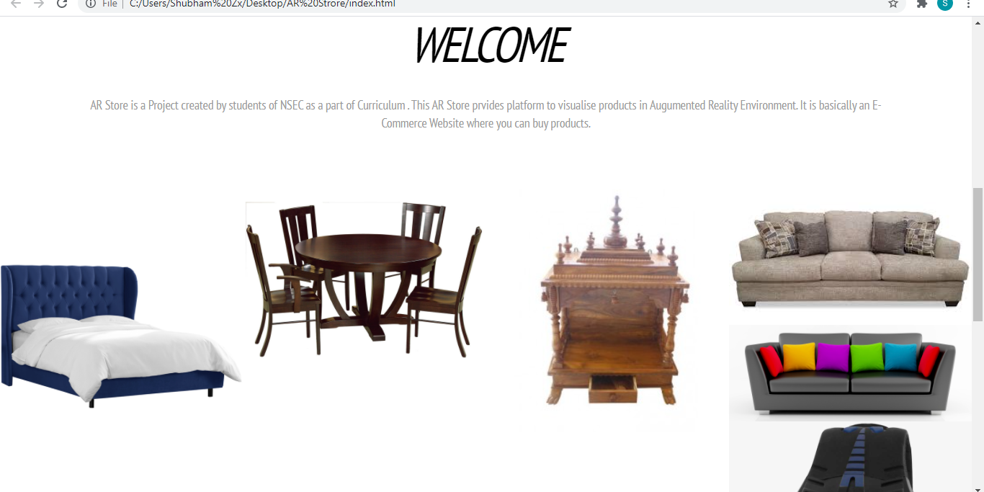
AR STORE-WEBSITE

Slide 11
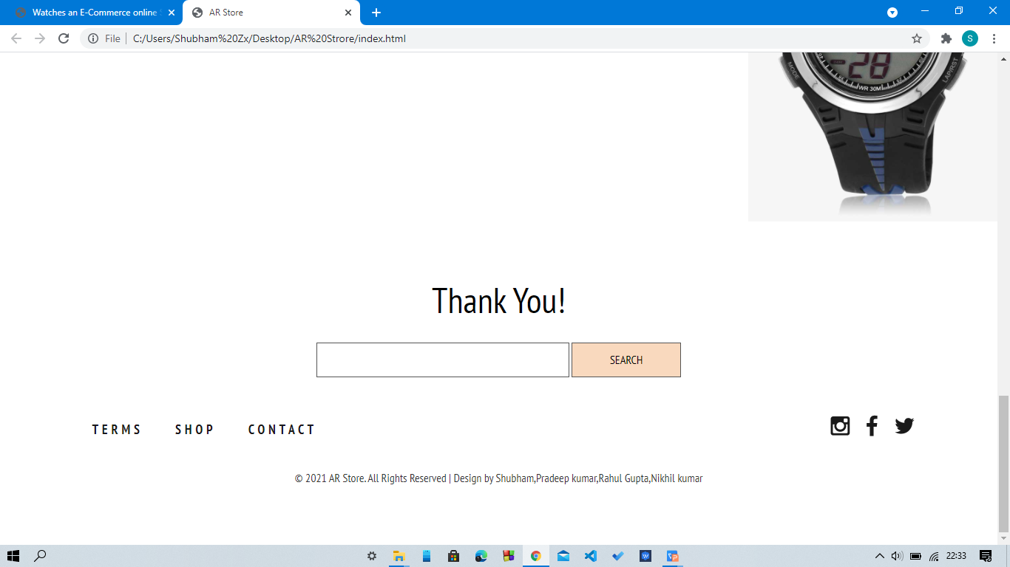
AR STORE - WEBSITE

Slide 12
Architecture of Website
Index.html
This is the home page of our website. It is created using Bootstrap Platform.
Brands.html
This is used to display the products available in stock.
Checkout.html
This is used when a costumer has to proceed the payment process.
Contact.html
This contains details of every member involved in making this site.
Download.html
Lets us download the Reality AR application.
Login.html
Lets us login in the our account on site.
Register.html
Lets us register in case of a first time user.

Slide 13
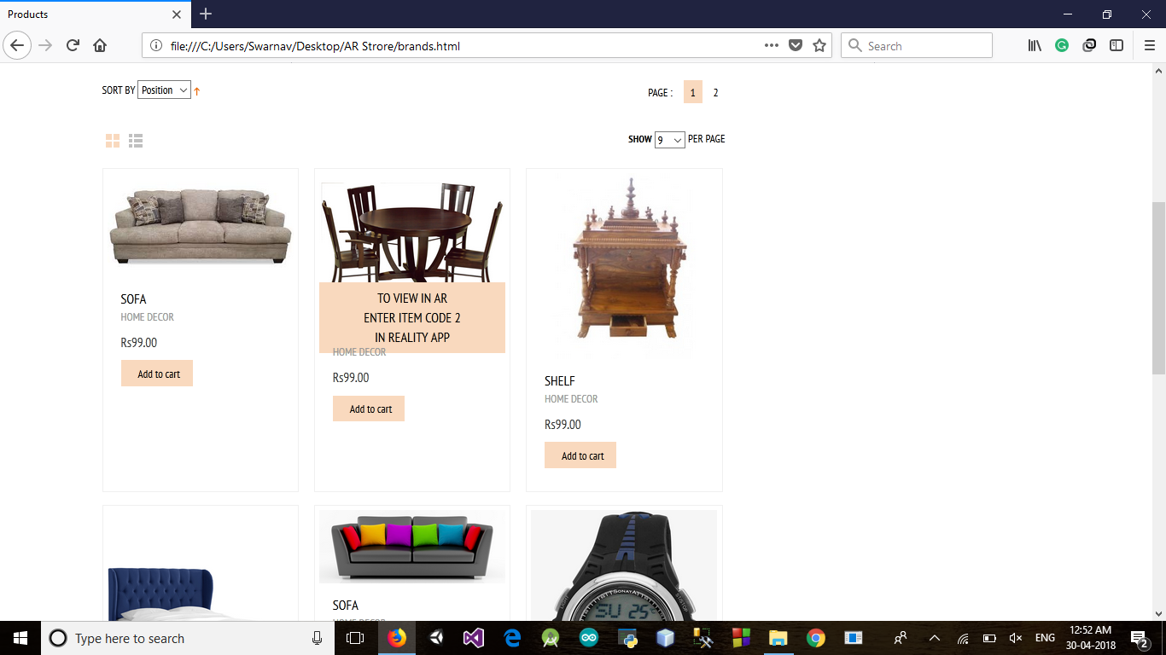
The Shopping Process…..
You can choose your desired item and add them to cart.
To see in Augmented reality : hover on the product and enter item code to REALITY APP.
Click on Add To Cart to add the item to cart that you want to purchase.

Slide 14
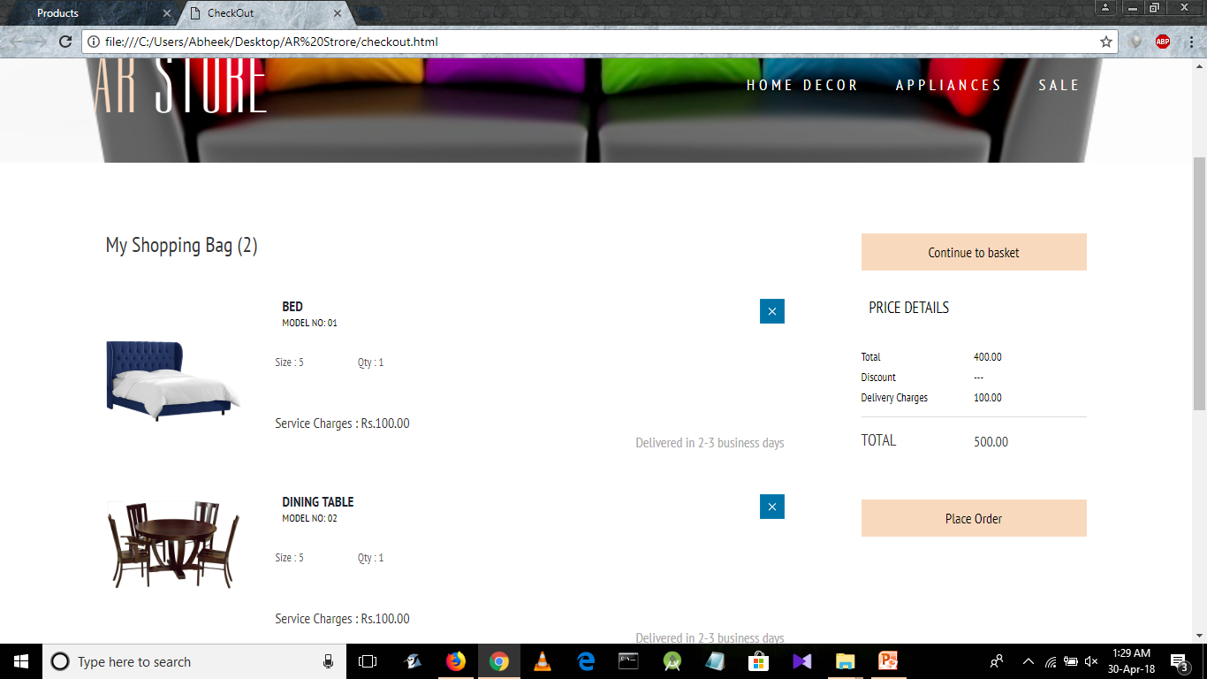
The Shopping CART…..
You can store your items to purchase from here.
To delete item from CART click on X .
To purchase items click on Place Order.

Slide 15
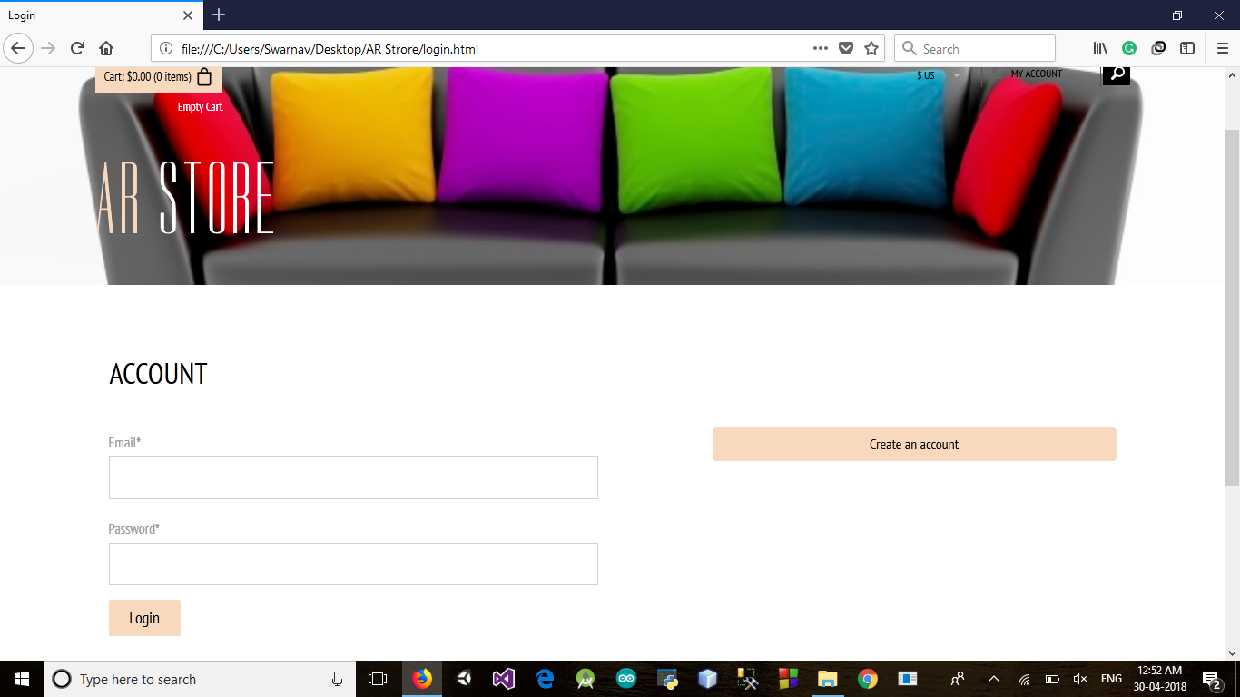
LOGIN…..
You can Login to the website to utilize augmented reality facilities.
Enter your Email and Password to Login.
Press on Create Account to create new account.

Slide 16
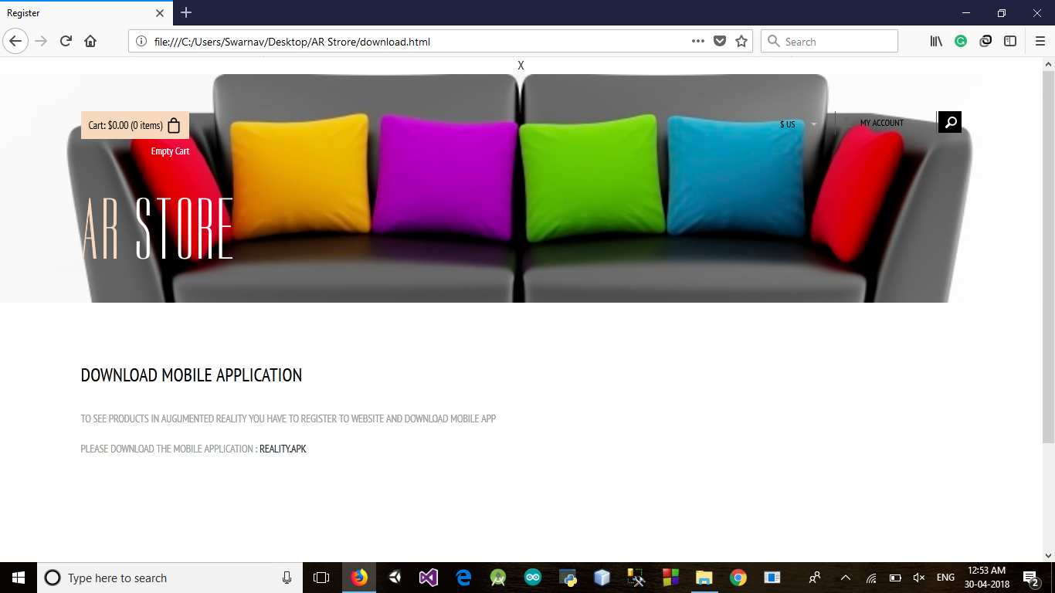
LOGIN…..
After you Login you can download the Reality.apk mobile app to view products in real environment.

Slide 17
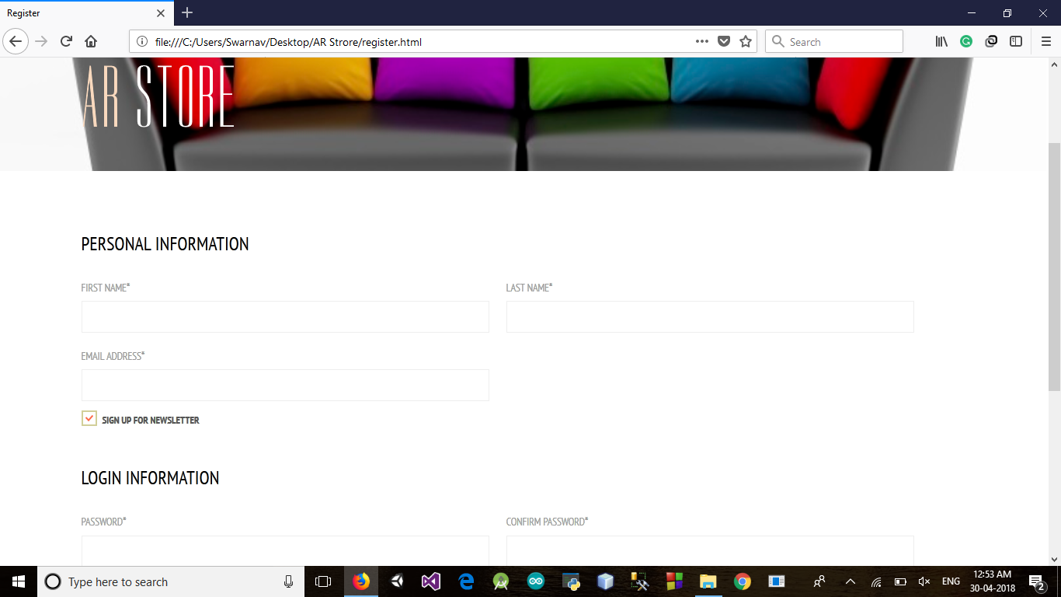
REGISTRATION…..
Fill in the Personal Information fields and Login Information fields for new Registration.
Click on the Submit button to complete your Registration.

Slide 18
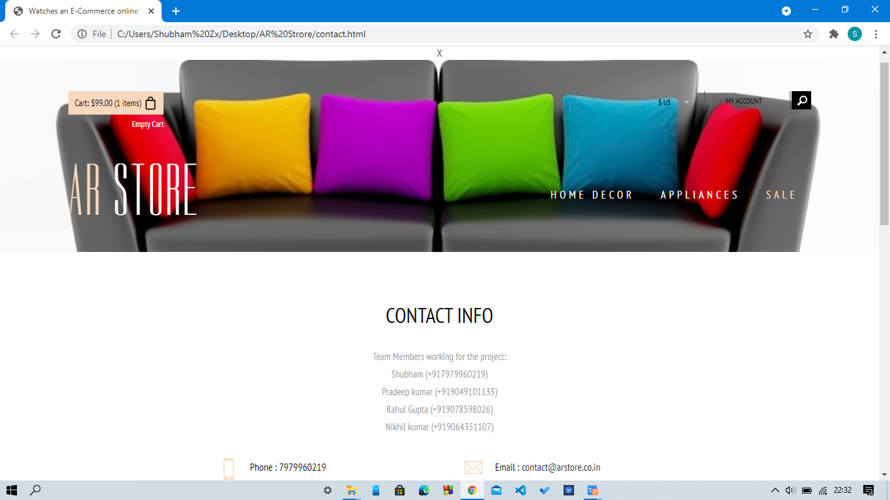
FEEL FREE TO CONTACT US…..
Fill the Feedback Form to help us further improve our site.
Contact information of the team is provided here.
For any queries feel free to contact or email.

Slide 19
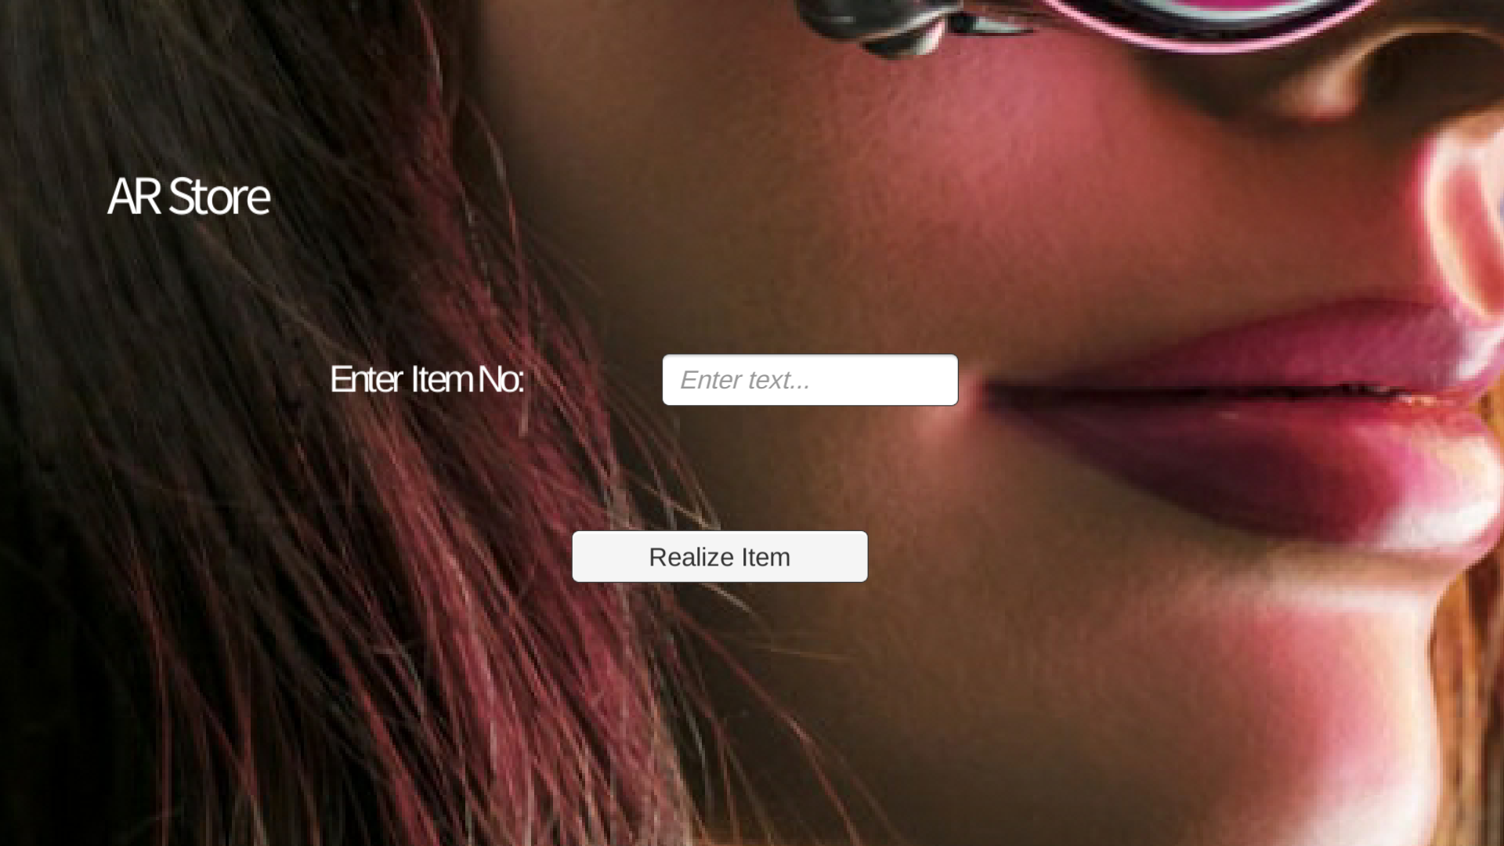
REALITY AR

Slide 20
REALITY AR
Use this app to see Product in real life environment.
Download the app by logging in to the website.
Enter the item code and click Realize item button to visualize the product in real life.

Slide 21
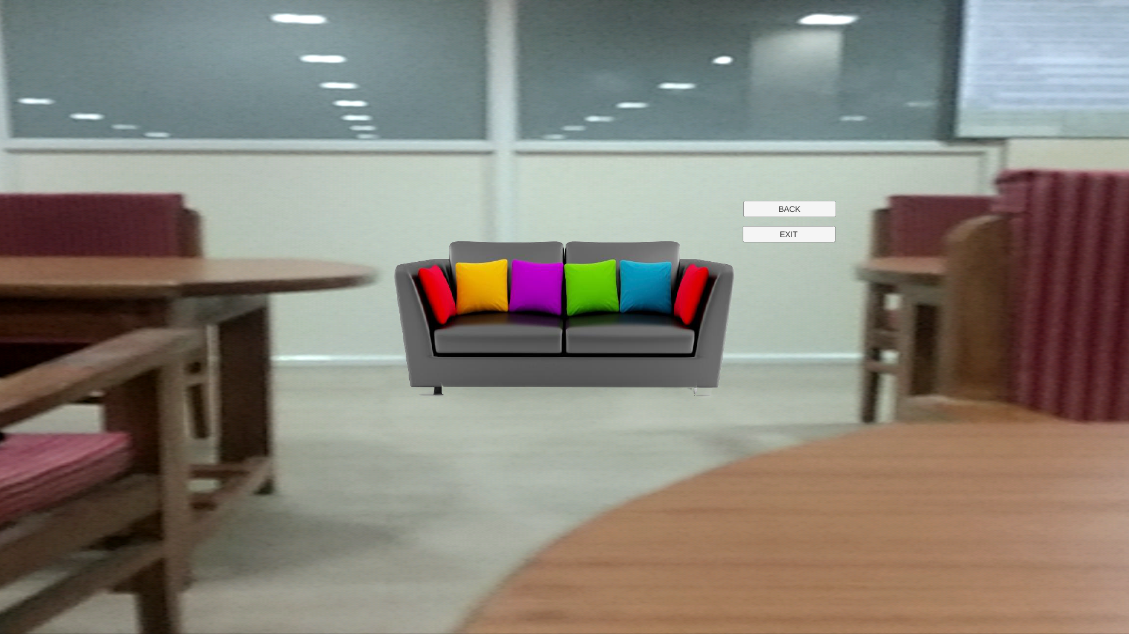
REALITY AR

Slide 22
Construction of Application:
Created using unity IDE for the front end development of the mobile application.
We used Vuforia to implement AR Camera to visualize products in real-world.
We used Corel Draw to make a object Augmented by removing its background and re-pixelate it.

Slide 23
CONCLUSION
Augmented Reality is far behind Virtual Environments in maturity. Several commercial vendors sell complete, turnkey Virtual Environment systems. A few monitor-based "virtual set" systems are available, but today AR systems are primarily found in academic and industrial research laboratories.
Taking a new approach towards e-commerce can be really fruitful and beneficial for our society. Changing our ways and being familiar with new technology will help us step into the new future with an edge.

Slide 24


